Slide 1





Drones
Traffic Management
TEAM 2
Alejandro Chacon
Arush Pamulapati
Nisa Putri
Shwetha Sanjeev
Stephen Payne
Ujwal Gupta
Notes:
Introduce project name and team members

Slide 2

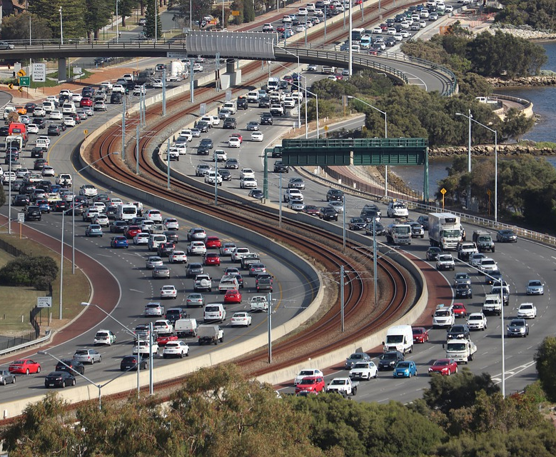

Notes:
Being informed about the traffic conditions in the area a person lives in, traveling to, or commuting is very useful since it could help them plan or save time by selecting the most effective route. We wanted to create a mobile application that will inform the users at a new speed about these traffic conditions.

Slide 3
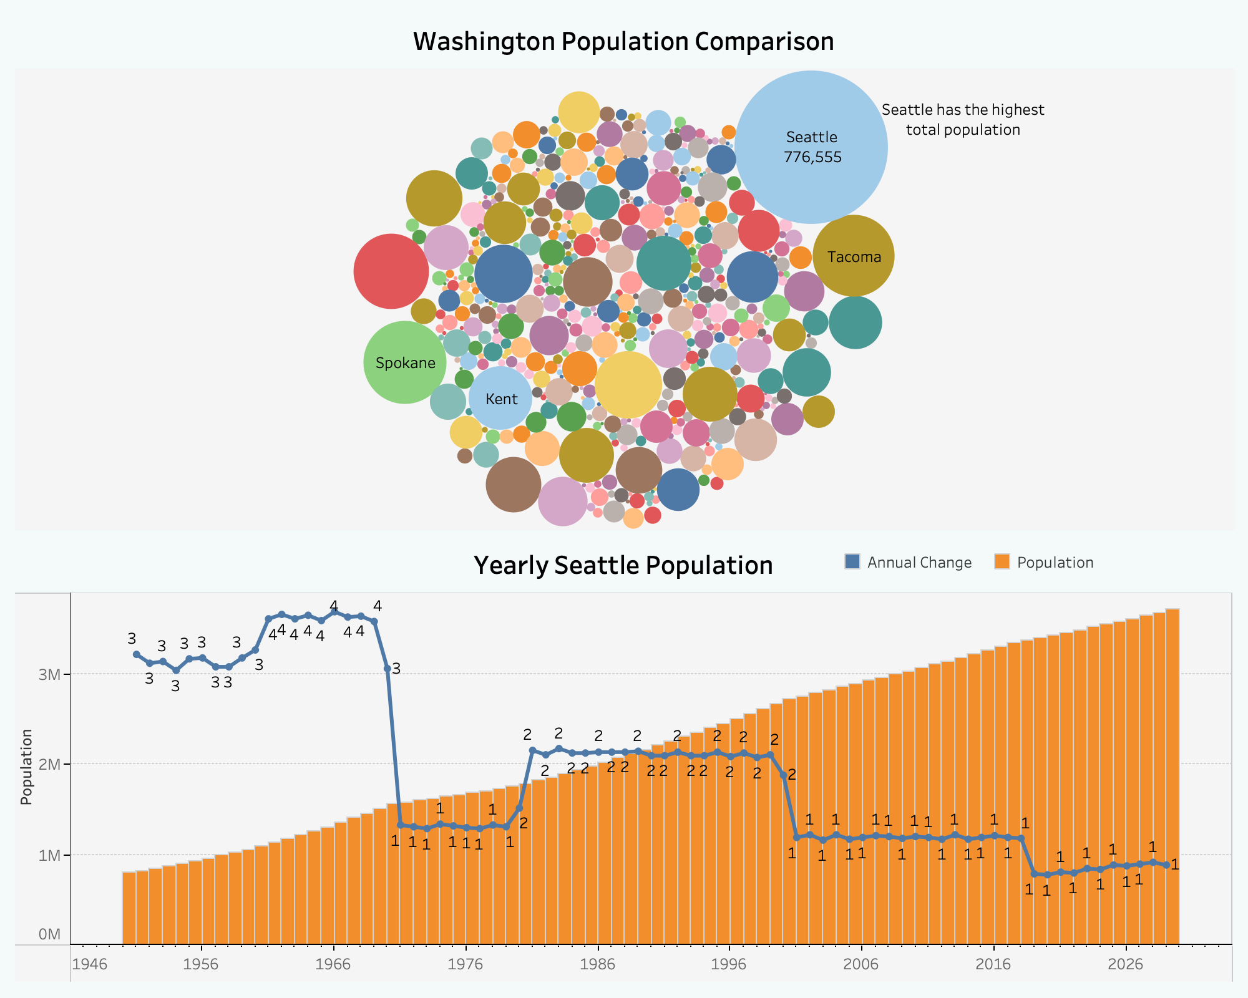
Project Vision
Why Drones? Why Seattle?
Notes:
With the help of drones that will travel around the city, we will provide fast updates in real-time to city residents through our mobile application. The application will provide alternative routes based on the live footage shared through our drones.
After consulting with Dr. Wang, we chose a city where the population is growing. Charlotte, Austin, and Seattle were the final candidates. Using a website called macrotrends.net, we chose Seattle to implement our project since it showed growth in the last couple of years.

Slide 4
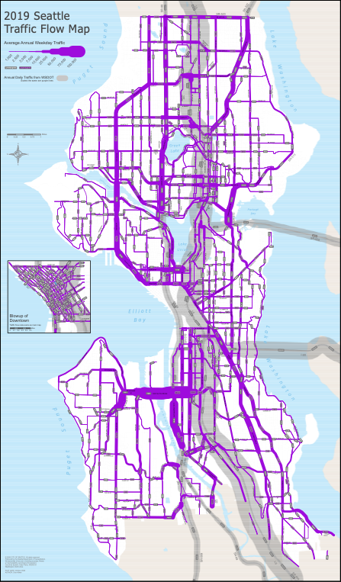
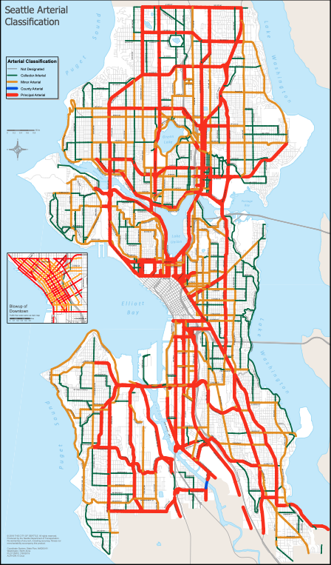
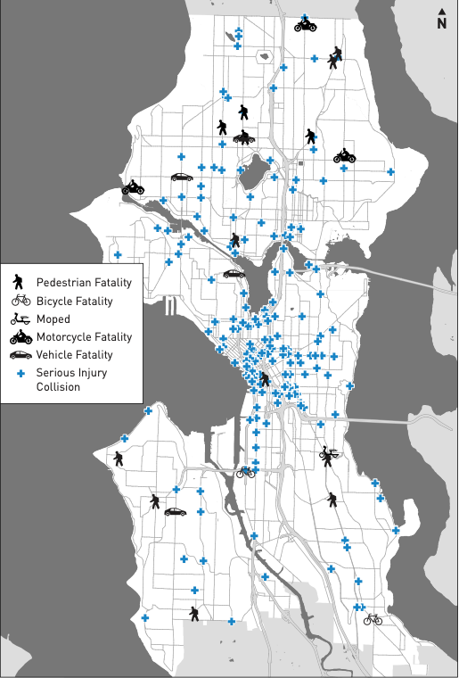
Seattle’s Traffic Index, Flow and Accidents
Notes:
The team found valuable information on Seattle’s traffic thanks to their 2019 traffic report.
Here we looked at where the traffic flow was the greatest (left image).
What the main arteries or roads of Seattle are (center image).
And where the serious collisions would happen (left image).
These visualizations allow us to decide where to deploy our drones to maximize our efficiency in monitoring traffic by considering where we might expect an accident or the influence traffic flow might have over the rest of the city.

Slide 5
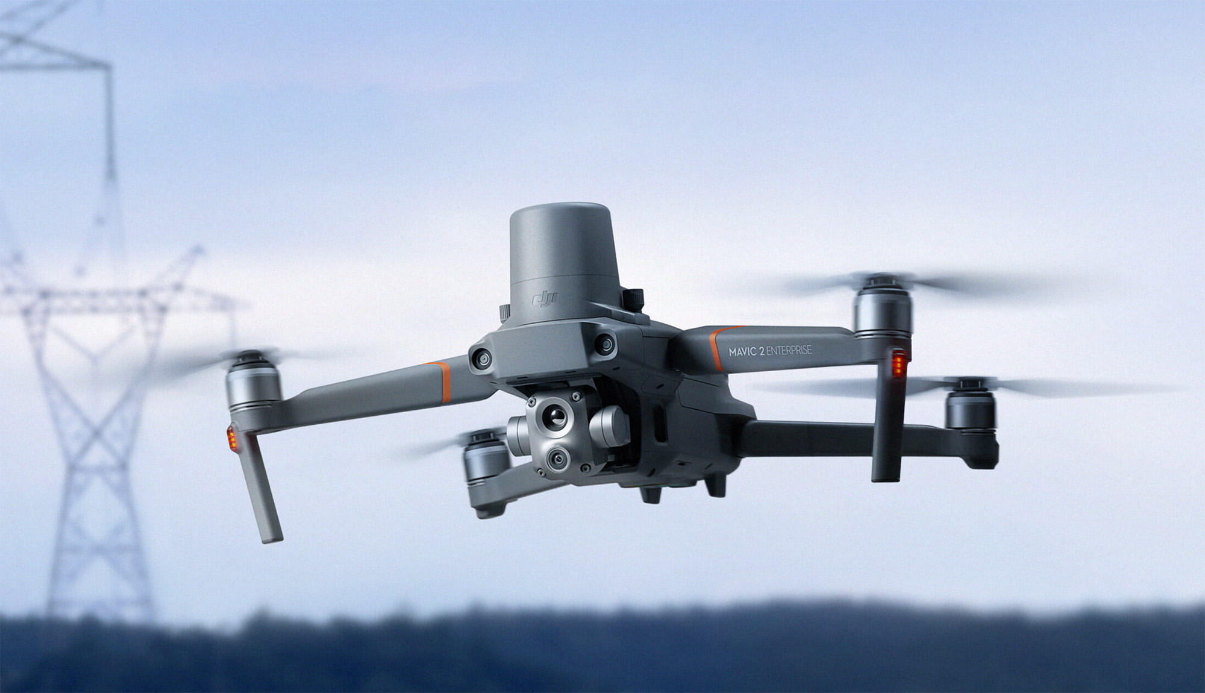
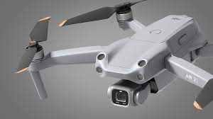
Drone Selection
 | DJI Mavic 2 Enterprise | DJI Air 2S
Price | $1,200 | $999
Camera | 4K Camera with an optical zoom of 2x and 3x | 4k video at 60fps and a 5.4k video at 30fps
Flight time | 31 minutes | 31 minutes
Range | 5 miles | 18.5 km
Storage | 24 GB internal storage | 8 GB internal storage
Autopilot Software | DJI GS Pro | APAS 4.0
Notes:
After thorough research on many different drones, the team finally narrowed down the decision to two models, DJI Mavic 2 Enterprise and DJI Air S2. If the local government or DJI agree to work together, we will utilize the DJI Mavic 2 Enterprise; otherwise, we would use the DJI Air 2S. These drones were finalized based on their prices and features that fulfill our needs.
4k quality for live streams
31 minute flight time greater than common flight time for drones of 20 minutes
DJI Air 2S is a cheaper option in comparison to the DJI Mavic 2 Enterprise however the DJI Mavic 2 Enterprise has more advanced technologies that could be useful to our project.
For example the DJI Mavic 2 features a camera that has more zoom capabilities than the DJI Air 2S.
This could be very useful to us since it could allow our team to see what is going on in roads and highways more up close, which could help us make more accurate decisions.
Both drones feature different autopilot softwares. The DJI Air 2S features APAS 4.0 and the DJI Mavic 2 Enterprise features DJI GS Pro. Both softwares have the ability for autonomous flying however the DJI GS Pro has features that upgrade the experience of using an autonomous flying drone. For example the DJI GS Pro has an iPad app where you can create pre planned routes through the app and data about the drone flights are also available on the cloud. Also with the DJI GS Pro app, it makes it easier to view all of the drones and its data directly on the app.

Slide 6
Funding
Sources of Funding:
City funding
Start-up fund
Restaurant Partnership
Costs:
Price without contract: $56,400
Team hiring costs: $325,000
Equipment Costs: $11,865.95
Revenue Generators:
Ads earnings per user per day: $1.6
Ad free version: $4.99
Projected Revenue:
$123,520 per month or $1,482,240 per year.
Notes:
The first source of funding would be to work together with the city/local government and DJI in the hopes that they will support us by creating a partnership.
Another plan would be solely relying on our start-up funds from our team and the app revenue itself.
The total funding required to purchase the drones without any contract with DJI is around $56,400.
The cost of hardware and hiring engineers and analyst to operate and maintain the company is around $325,000
$70,000 to $80,000 each for developers of mobile app
$60,000 to $65,000 each for server administrators
$50,000 each for drone support/monitors
The total funding cost of all the equipment we need would be $11865.95
To cover these numbers we plan on using ads that will make us $1.6 per user per day and in 2 years we’ll consider launching a paid version for $4.99.
We’ve decided to partner with local restaurants to promote them in exchange of earn revenue for any of our users that visit them using our app.
We project that the revenue we will get is $123,520 per month or $1,482,240 per year.

Slide 7
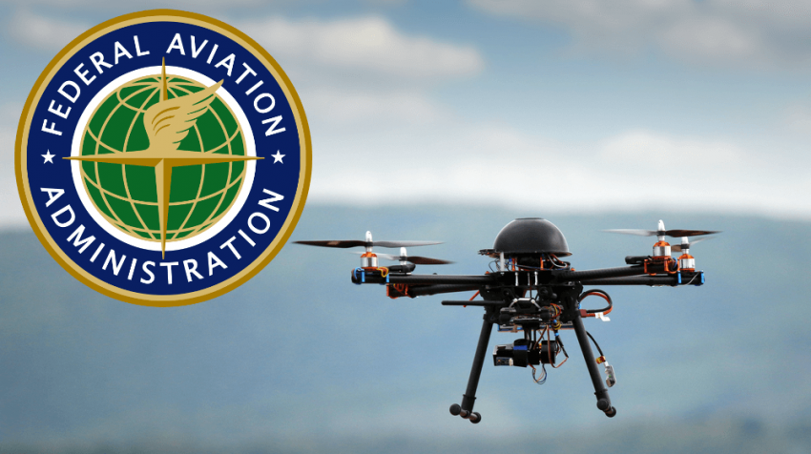
User Privacy
The FAA and drones
Notes:
Since drones fall into new and advanced technology, the FAA has not finalized its privacy laws. We plan to use drones for traffic management and are expected not to have many restrictions. Based on the current Seattle law, drones can fly within the city with a proper permit and licenses and as long as the drones are recording sky-view video with no audio.

Slide 8
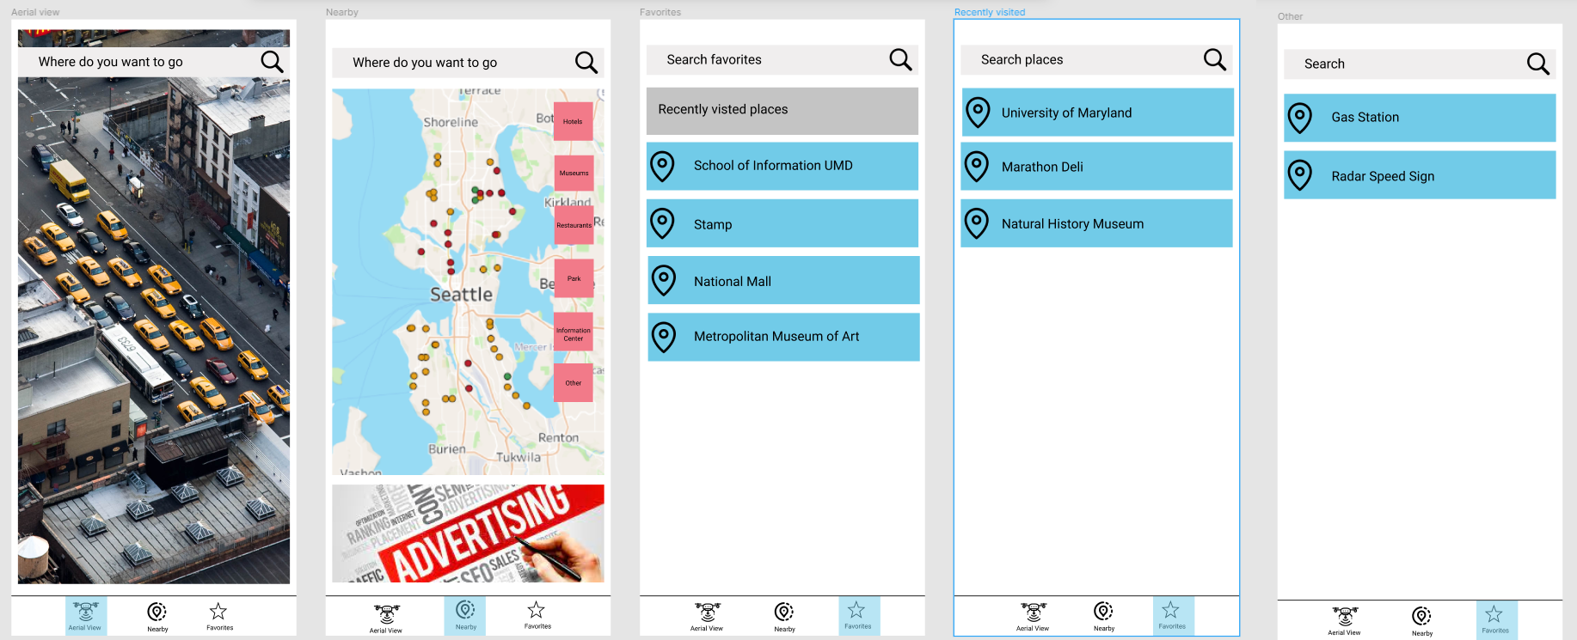
Prototype
Notes:
The first image on the very far left is the live stream on location. The second image to the left is the GPS with an advertisement on the bottom. People can type where they want to go, and GPS will provide directions. The third image (center) shows how to add favorite locations to find directions quickly in the future. The fourth image shows the user's location search history, and the fifth image shows another search screen with additional options.
Aerial View which shows the live stream video from the closest drone’s location. They would be able to zoom in or zoom out as well as pause or resume
Each screen on our app will have a search bar for users to type their destination address.

Slide 9
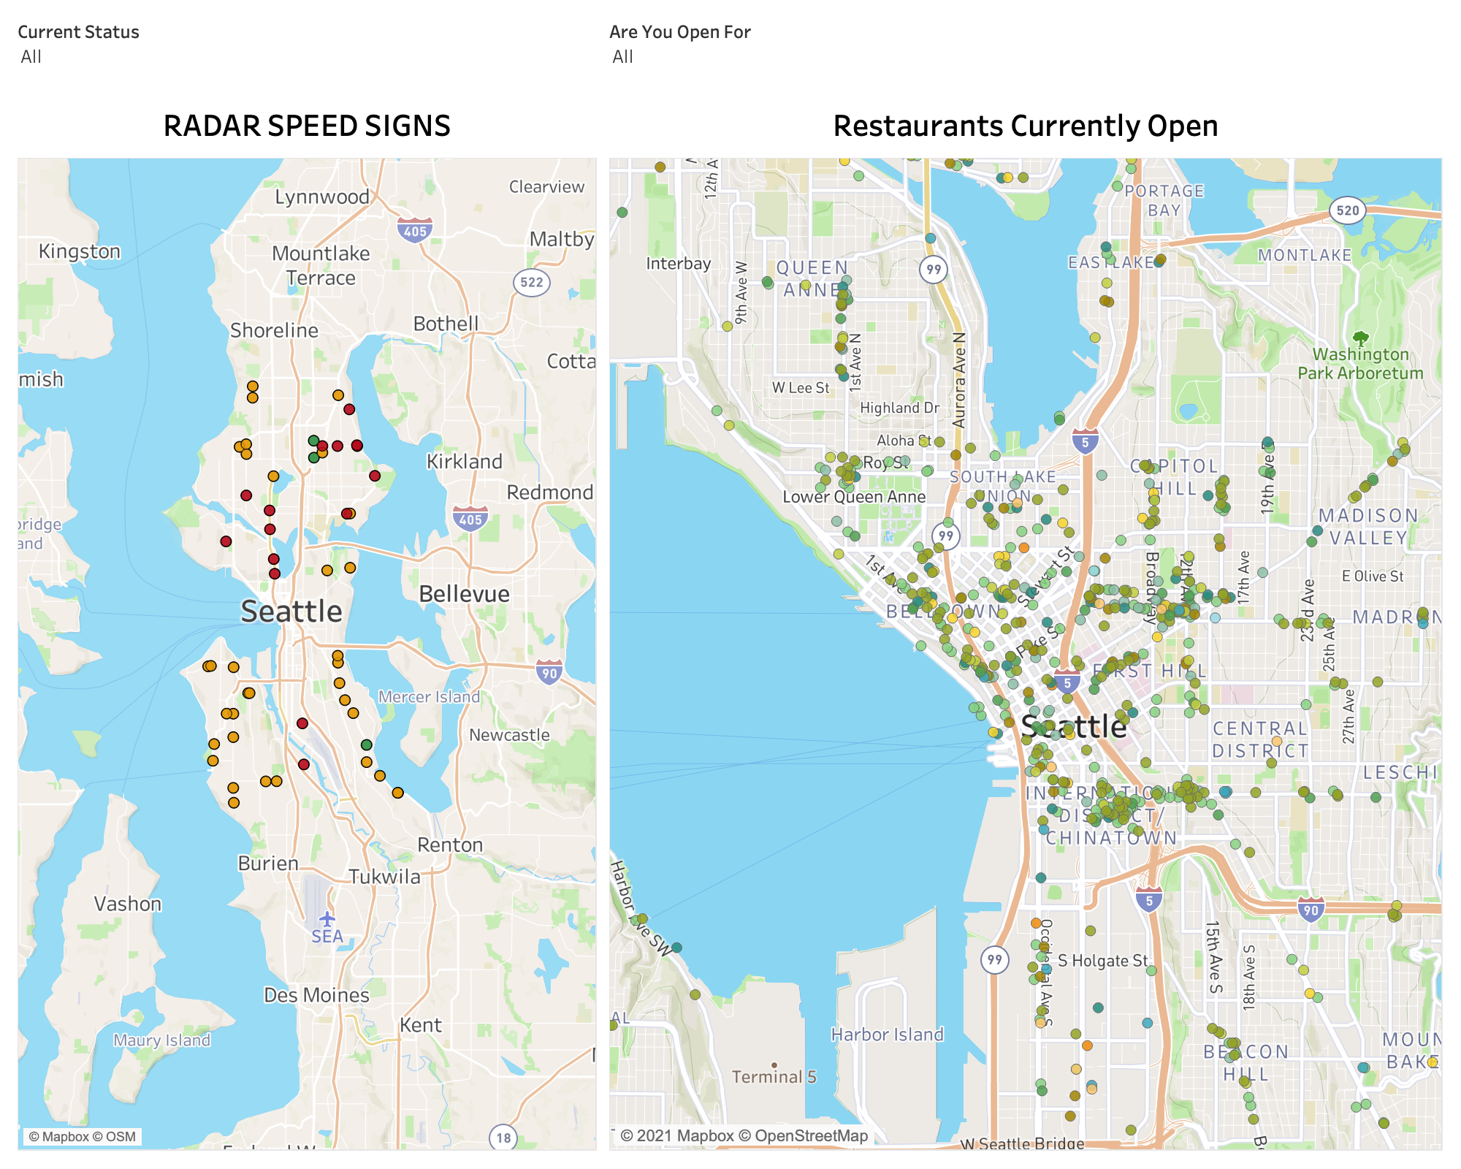
Project Development
Features:
Speed radar
Restaurants
Notes:
To show our users how our map might look, we developed two different examples of the additional features provided.
The first feature is checking where speed radars are located. The user will be able to zoom in or click on the marker to see the signs exact location and the current status of the radar.
The second feature will show the user what restaurants are currently open and quickly accessible without traffic with the option to filter out whether the restaurant is available for dine-in, pick-up, drive-thru, and other services.

Slide 10
Thank you

